Slide 1


Scottish Government
Health & Social Care Research Strategy
2015 - 2020
The ambition of this strategy is to increase the level of high-quality health research conducted in Scotland, for the health and financial benefits of our population, so that we are recognised globally as a leader in health science.
http://www.gov.scot/Publications/2015/10/5164

Slide 2
CSO Investments
Direct Research Funding
Response Mode Committees / Catalytic Grants
Clinical Fellowships / Charity Collaborations / Research Units
UK-wide Research Funding Contribution
Scottish-based research access to NIHR funding streams
EME / HTA / HS&DR / PHR
NHS Research Scotland Support Budget
Activity based allocation to NHS Boards
Researcher Support / NRS Fellows / CRF-type posts/
Topic-specific Networks & Specialty Groups

Slide 3

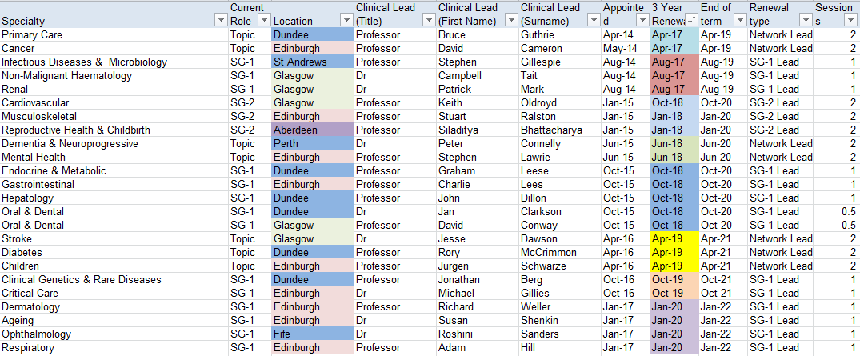
NRS Topic Specific Networks and Specialty Groups
10 Network Managers
4 Portfolio Managers
Total annual investment in topic specific infrastructure approx. £4.5 million

Slide 4


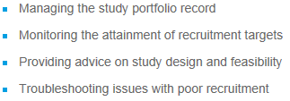
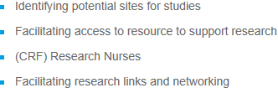

Slide 5


SHARE
A register of people aged 16 or over and living in Scotland who have said they are interested in helping with medical research.
They give permission to for the NHS to check their Datasets to see if they may be suitable for research projects.
Over 154,000 signed up

