Slide 1

Introduction to NRS…
and how to get involved
Dr Susan Shenkin
NRS Ageing Specialty Lead
Susan.Shenkin@ed.ac.uk @SusanShenkin

Slide 2
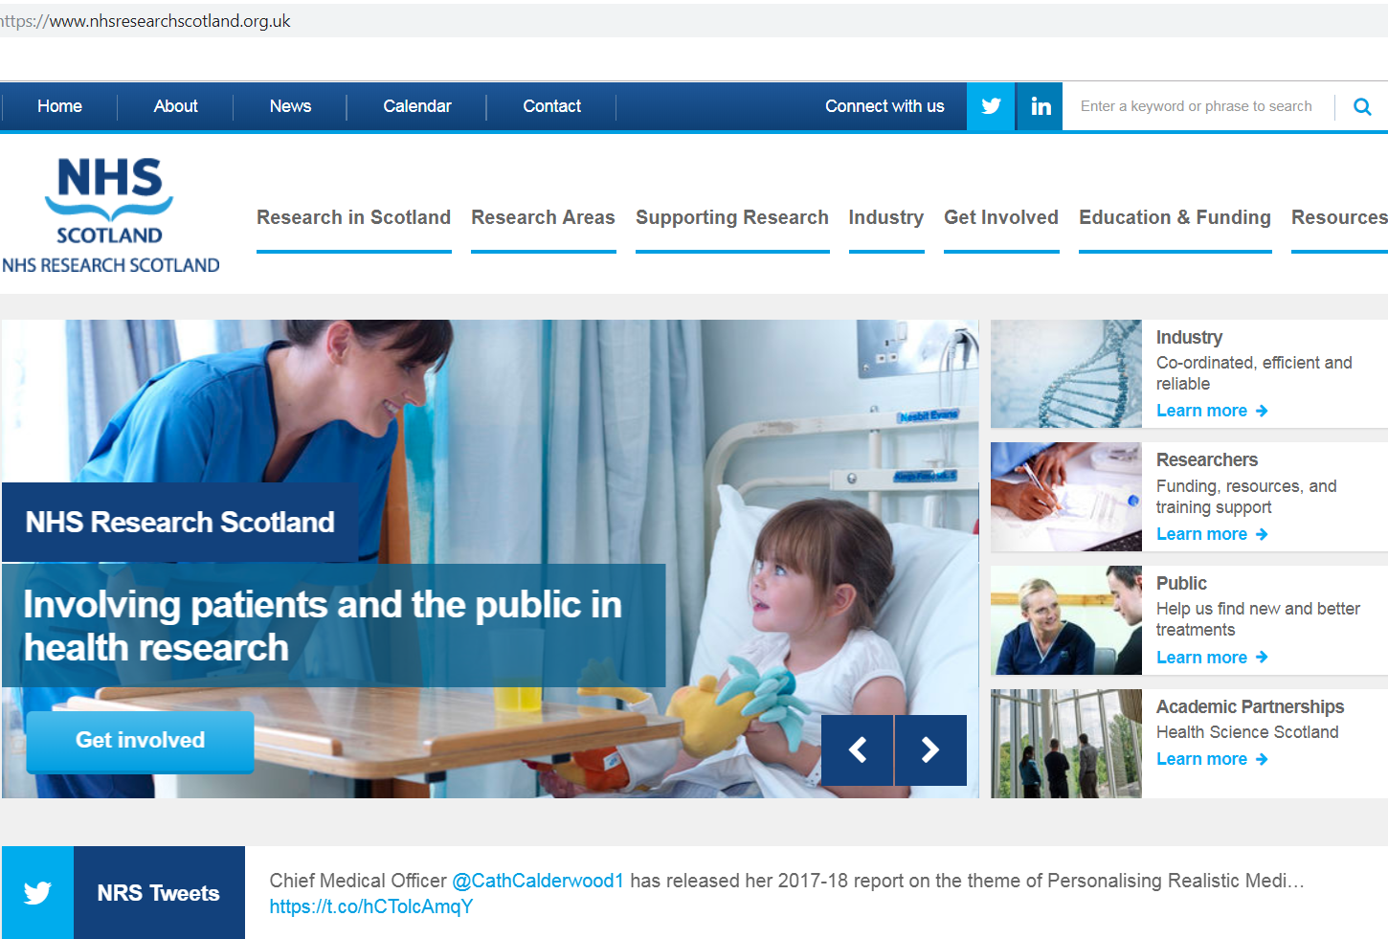

Title

Slide 3
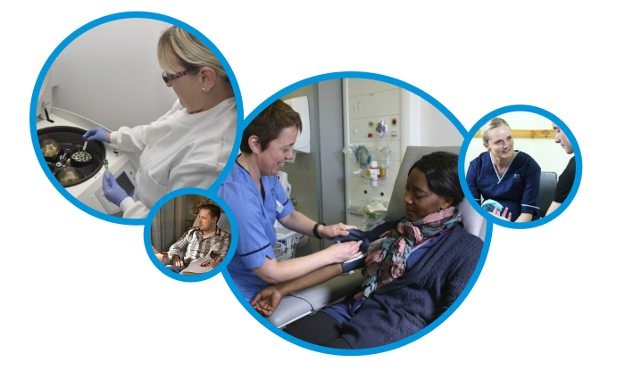


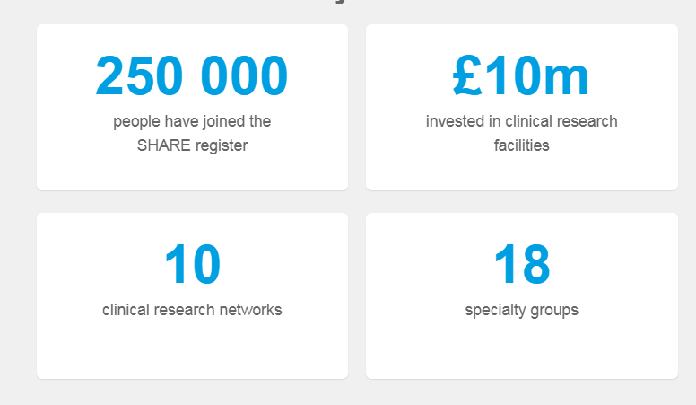

https://www.registerforshare.org/
www.nrs.org.uk @NHSResearchScot

Slide 4
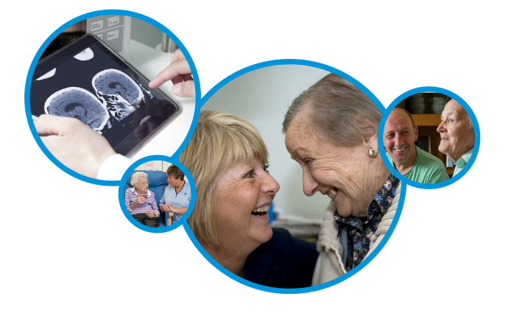
Ageing Specialty Group
Specialty Lead: Susan Shenkin
Performance Manager: Sharon Southern
www.nrs.org.uk @NHSResearchScot

Slide 5
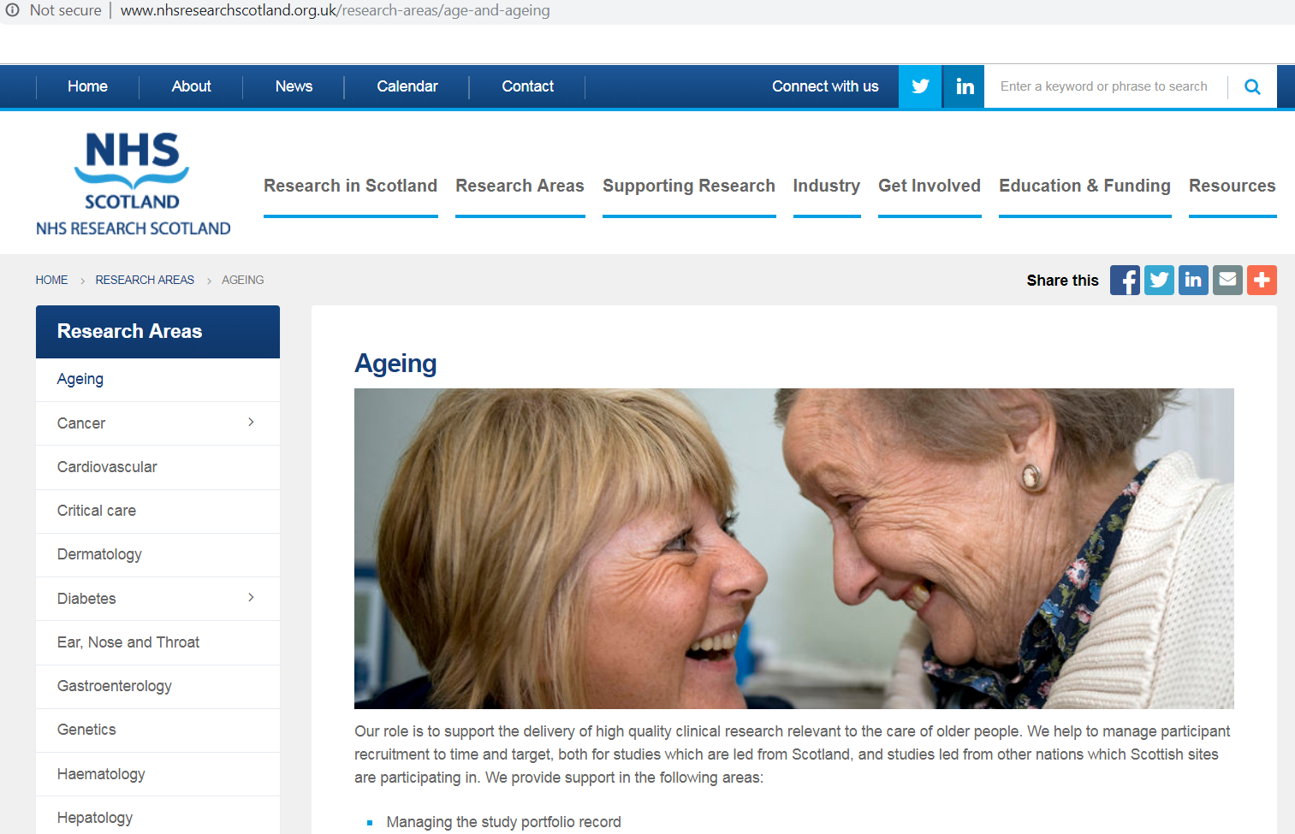
Title

Slide 6
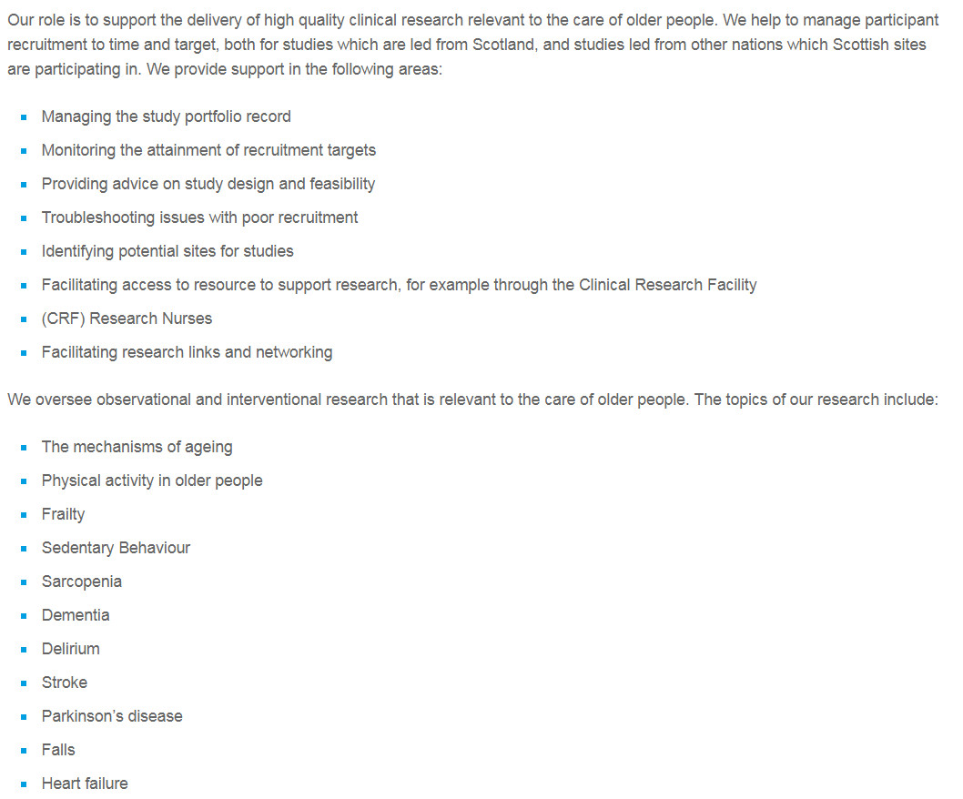
Title

Slide 7
Current active studies
27 open studies on the UK Ageing portfolio
  18 led from England
  6 from Scotland
  3 from Wales
6 studies In Set Up (all led from England) - 2 Commercial, 4 Non-commercial

Slide 8
Current active studies
Lothian Birth Cohort 1936 – cohort study of healthy ageing (Lothian)
Ageing-GB – gut microbiome (Aberdeen)
RAINDroP – pilot RCT of iron deficiency anaemia treatment (Aberdeen)
Resistance exercise in older people – feasibility study (Glasgow)
Supporting specialty
SoSTART – RCT of anticoagulation for AF post haemorrhagic stroke (Lothian)
65+ study – CJD epidemiology in atypical dementia (Lothian)
ASCRIBED – CSF biomarkers in hip # and dementia (Lothian)
SENIOR-RITA – Treatment of older people with NSTEMI (Lothian)
CHIPPS – RCT of care home prescribing (Grampian)
REFLECT – RCT of fluoride to prevent dental caries (England)
Improving care pathways in PSP and CBD (Grampian)
LACI-2 – RCT for prevention of recurrent lacunar stroke (Lothian)
Database studies
Antibiotic research in care homes – ethnography/health psychology/epidemiology (Tayside)
Admission to care homes from hospital – data linkage (Glasgow)

Slide 9
How to get involved
Be inspired at conferences!
Go on a research methods course
Have a local journal club
Do a ‘GCP’ (Good Clinical Practice) course
– then you can recruit for local studies
Ensure your clinical data can be used for health records research
Sign up for SHARE (www.registerforshare.org)
Sign up for NRS Ageing Newsletter (ageingscotland@ed.ac.uk)
Talk to active researchers
www.nrs.org.uk @NHSResearchScot

Slide 10
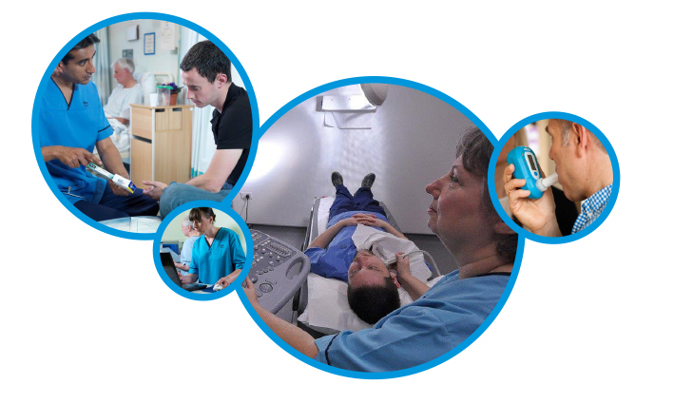
Susan.Shenkin@ed.ac.uk
www.nrs.org.uk @NHSResearchScot

